Slide 1

Moneyball vs. Millionaires: Examining the Need for a Salary Cap in Major League Baseball
Thomas Sigall

Slide 2
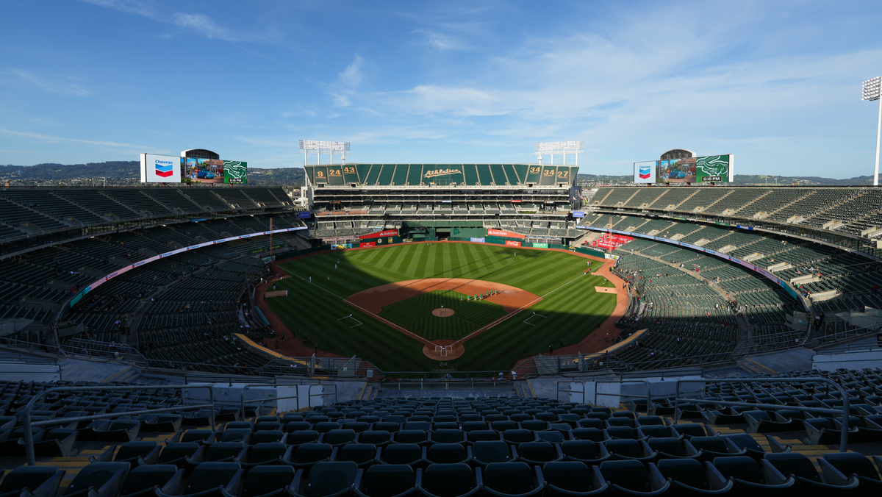
The 2002 Oakland Athletics
Notes:
The legendary 2011 film "Moneyball" tells the story of the 2002 Oakland Athletics, a team taken over by general manager Billy Beane who led them to a historic season, winning 103 games, winning their division, and making the playoffs. The reason that season was immortalized into a movie, however, was not simply because the team had a historically good season. The 2002 Oakland Athletics did something far more remarkable. They were not just able to win, but they did it as a small market team, with an incredibly low payroll, the third lowest in the league in 2002.
The Athletics had seen periods of success in their franchise's history, but struggled to end the 1990's. The problems they faced during that time were not unique to the Athletics. Many teams around the league were struggling because they could not keep up with the "big guys". The Athletics were and are considered a "small market" team. This means a variety of things, one being that they are located in an area with a lower population, meaning they bring in less money as an organization, meaning they have less money to spend on good players. They simply could not keep up with "large market" teams like the Yankees and Red Sox, teams with far deeper pockets. In 2002 alone, the New York Yankees spent $125 million on player salaries, the Boston Red Sox spend $108 million, and the Athletics spend a measly $40 million. In fact, many players would start with the Athletics and other small market teams, improve and become better ballplayers, then leave to the large market teams who could afford to pay them far more, essentially outbidding the smaller market teams.
The 2002 Oakland Athletics are a remarkable team because they were able to innovate and find value in players that did not cost nearly as much as the superstars New York and Boston were paying for. This was 20 years ago though, and now all teams use similar methods that were pioneered in that 2002 season. There is little value left to find out there on the smaller payrolls that these smaller market teams are given. This project is not about attempting to replicate what the 2002 Athletics were able to do. Instead, we will look at the system that forced them and all other small market teams to do more with less just to compete with large market teams. We will investigate the relationship between payroll and team success.

Slide 3
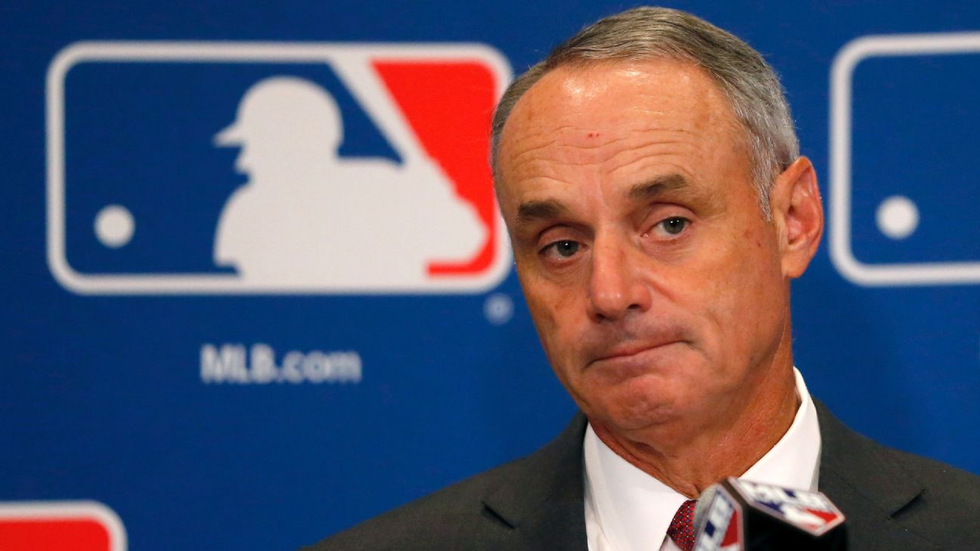
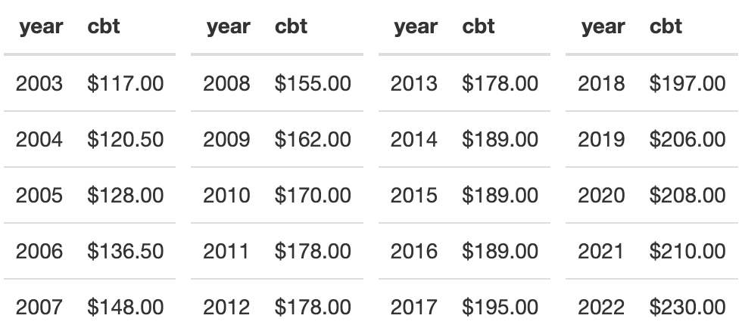
The Competitive Balance Tax
Notes:
To help decrease the gap between teams with deep pockets and teams without, most sports leagues in the United States have what is called a salary cap. This is as it sounds, an agreed upon limit on the amount teams can spend on player salaries. For example, the National Football league set its salary cap at $224,800,000 for the 2023 season. Teams are not permitted to spend more than that amount on their players and spend a lot of time trying to maneuver contracts to stay under that figure. Player salaries are by far the largest expense any team has and this hard limit on that expense helps to balance the playing field and close the gap between large market and small market teams.
The MLB, however, does not have a salary cap. There is no limit on the amount of money teams can spend on player salaries. Instead, they have implemented a system called the "Competitive Balance Tax"(CBT). An amount is agreed upon by the league, the CBT threshold, though teams are allowed to exceed this amount in their payroll. If they do exceed this amount, they are taxed at a rate proportional to the number of years they have been over this amount. This system has been in place since 2002 and the values for the CBT threshold over the years are as follows (in millions of dollars):
SHOW TABLE
Naturally, this value usually increase each year to keep up with various factors, such as inflation, increasing league revenues, and others. It is a fairly high value, as most teams have never passed this threshold in the 20 years of its existence. Enough teams do pass it, though, that it gives a good baseline to determine which teams are large market teams that spend big and which teams are not.
The theory behind this threshold is that it should punish wealthier teams for spending large amounts of money that smaller teams do not have. This should level the playing field and allow teams to spend similar amounts of money and encourage on-field competition as the way to determine the best team, rather than the league being a competition decided on who has the deepest pockets.

Slide 4
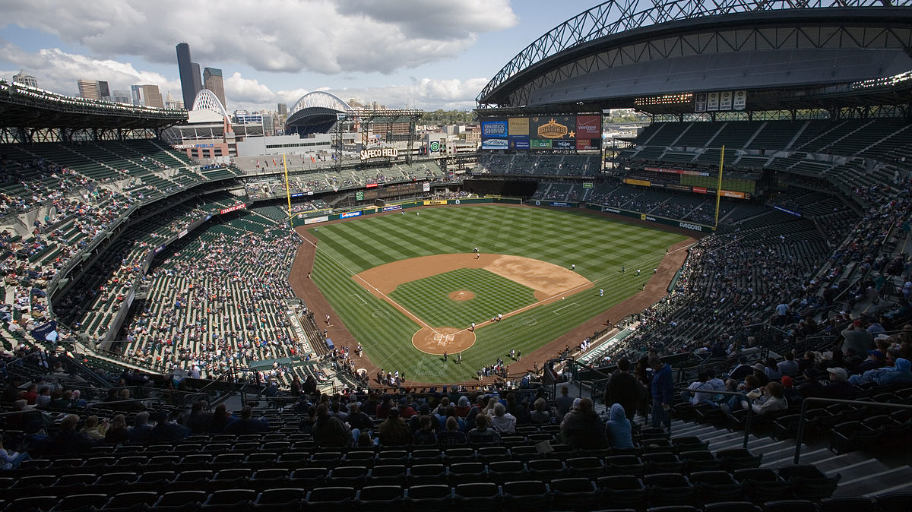
Does the MLB need a traditional salary cap?
Do teams above the competitive balance tax threshold win more games than teams that are not?
Is there a relationship between playoff teams and teams that are above the CBT threshold?
Do teams in large population centers win more games than teams in small population centers?
Notes:
Now that the system the MLB has put in place is understood, we can look at the objectives of this project. The overall question that will be looked at is as follows:
Does the MLB need a traditional salary cap?
To answer this question, we will look at the relationship between spending and winning and attempt to determine if the CBT system is effective at encouraging a competitive league by discouraging teams from spending so much money that smaller teams cannot keep up.
Various questions will be answered, such as:
Do teams above the competitive balance tax threshold win more games than teams that are not?
Is there a relationship between playoff teams and teams that are above the CBT threshold?
Do teams in large population centers win more games than teams in small population centers?
There is some concern that a salary cap would do little to address the real issue, that teams in big cities will just always have more money than teams in small cities. There are more people in New York than Oakland, so it may be the case that Oakland is just in a smaller market and no salary cap will ever fix that. However, if spending is more indicative of team success than city population, we will have evidence that spending is what needs to be limited rather than population. This would be an encouraging sign as the MLB has far more control over how much teams spend than population growth in its cities.

Slide 5
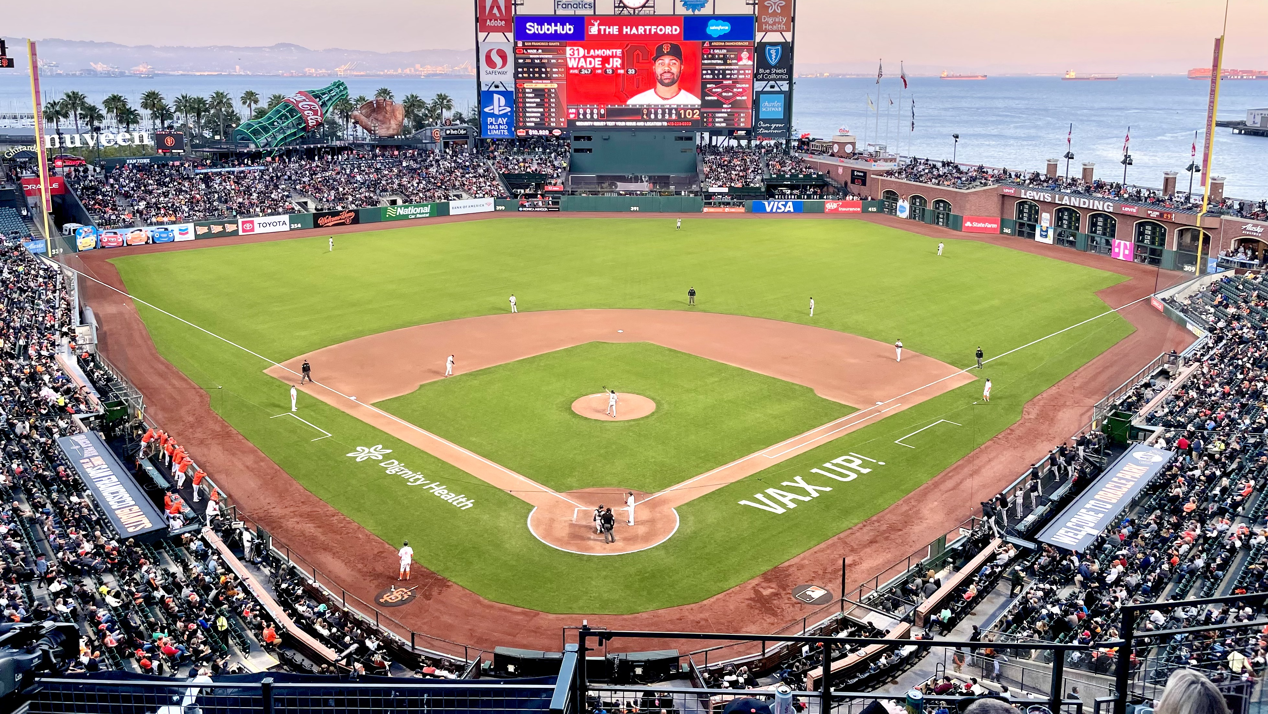
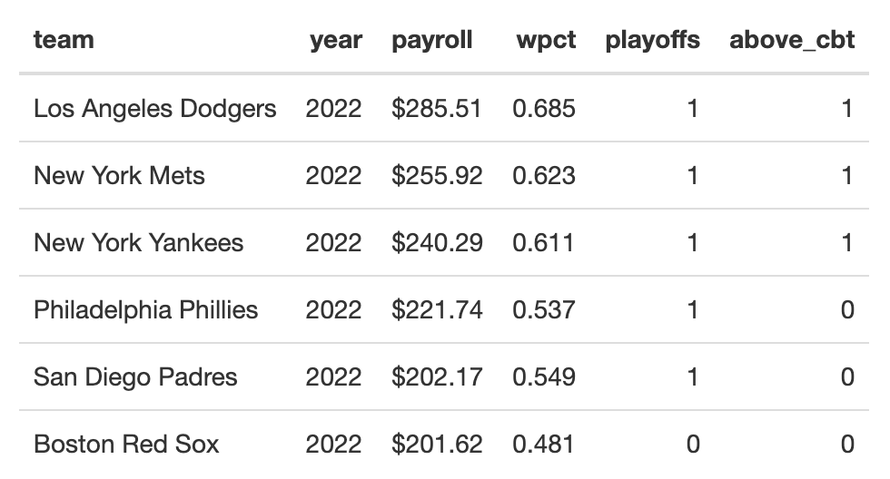
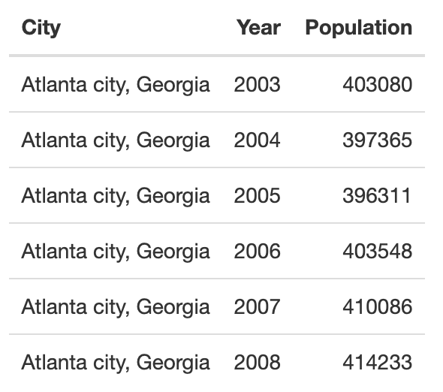
Tables
Notes:
This table includes team, season, payroll (in millions of dollars), winning percentage, if the team made the playoffs, and if the team is above the CBT on a season by season basis.
The next table is the population table used for that analysis, containing city and population numbers

Slide 6
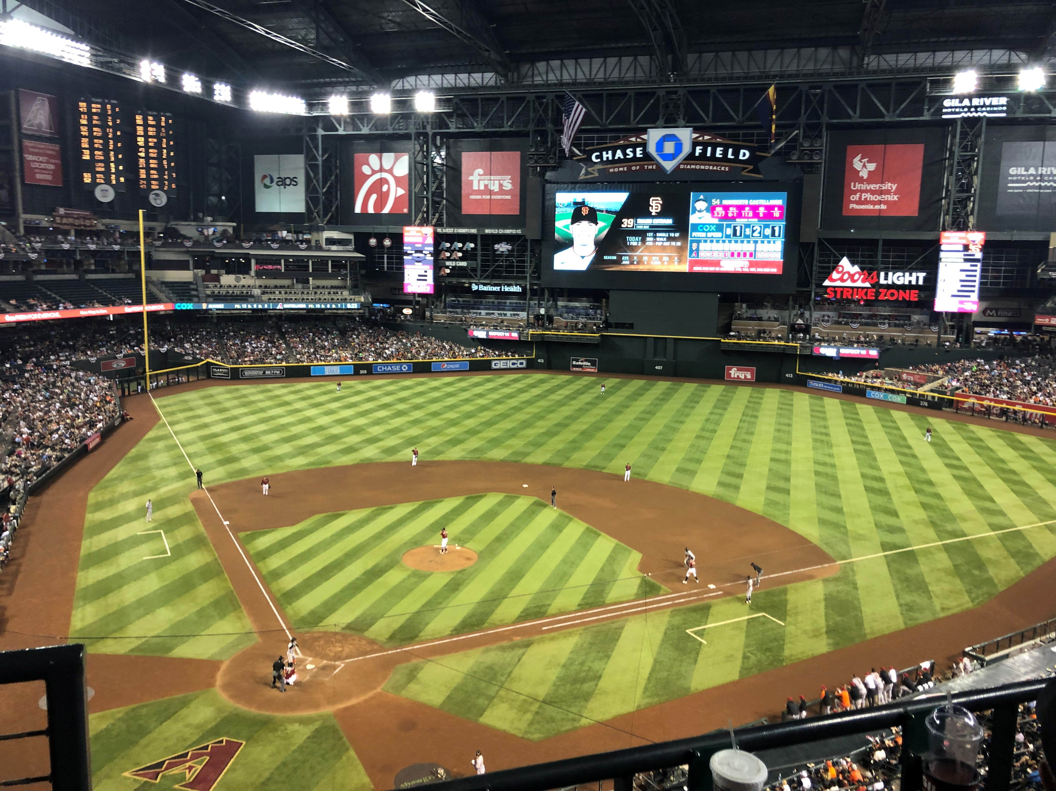
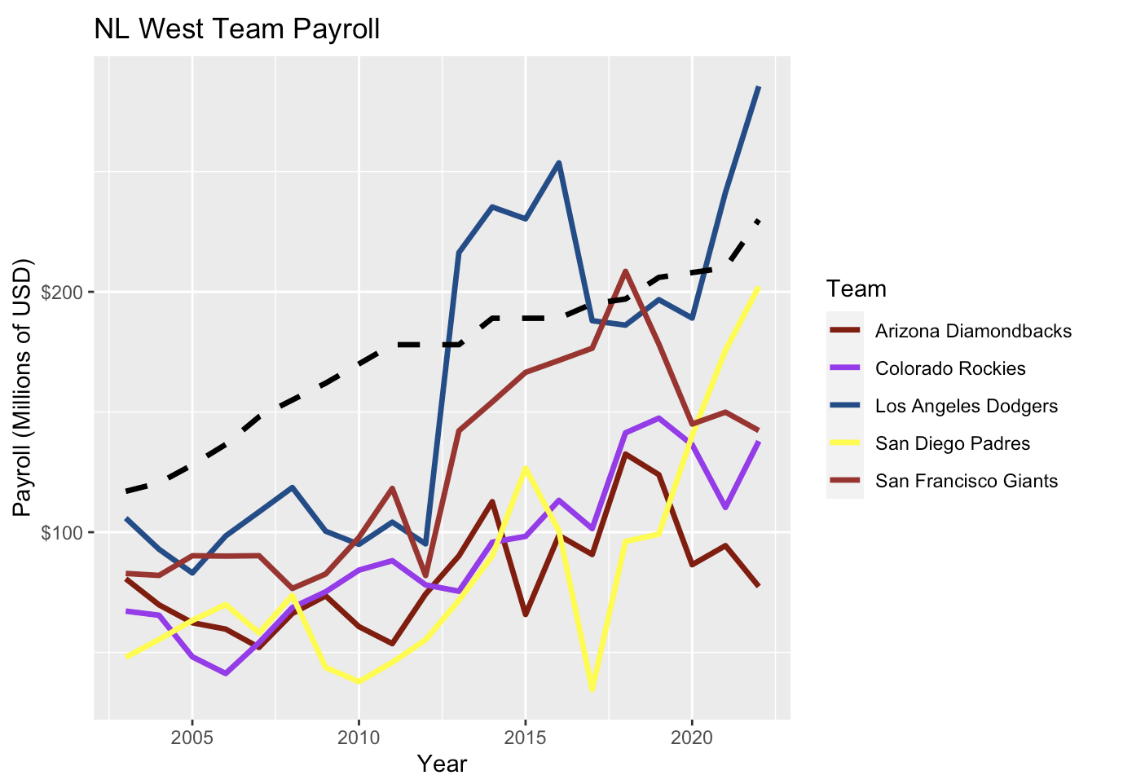
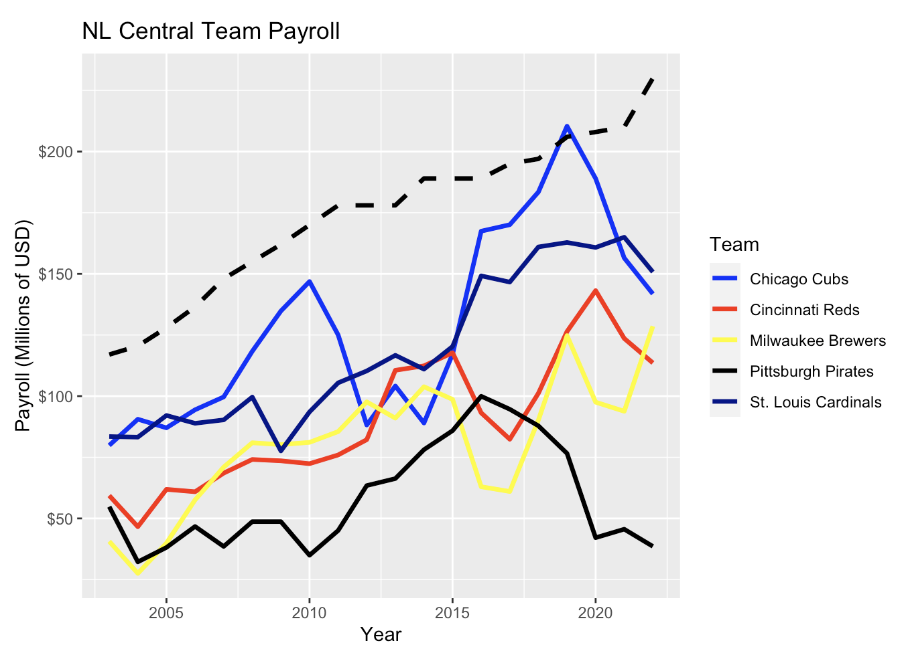
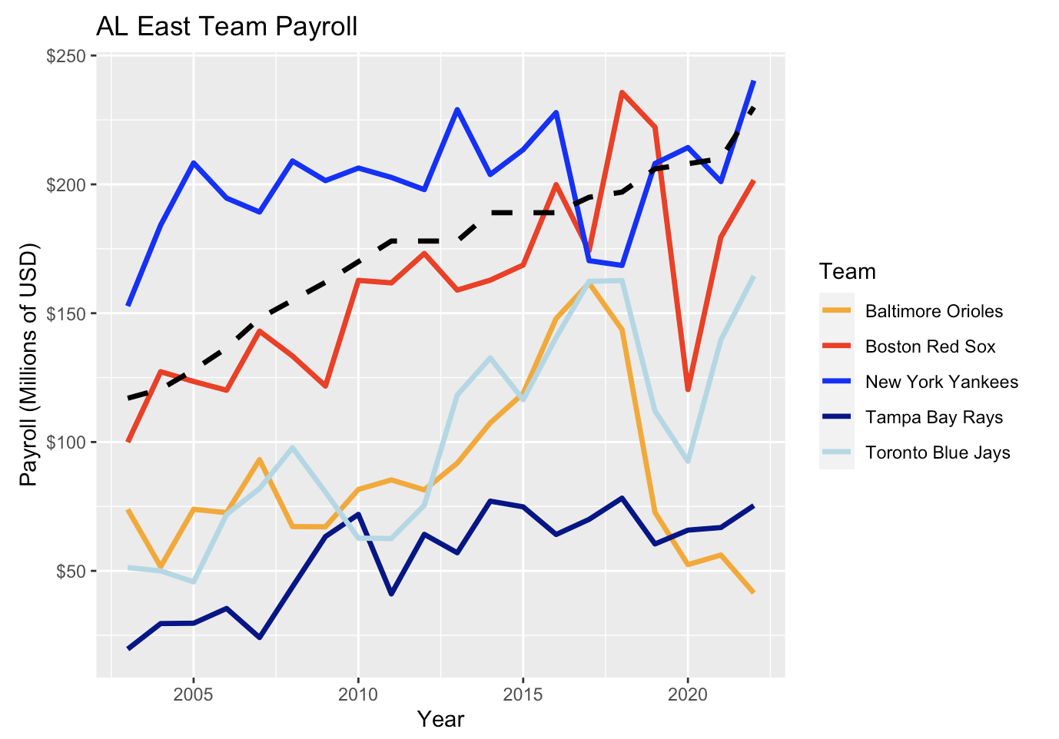
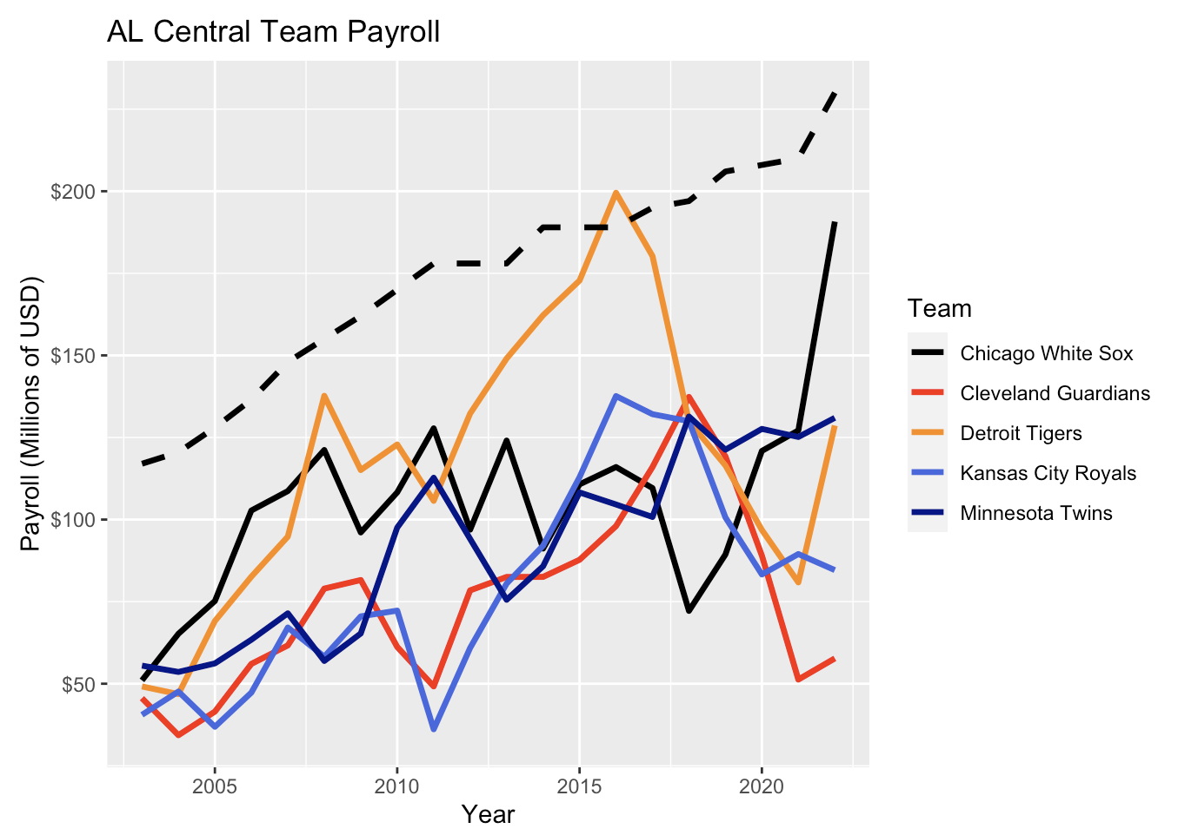
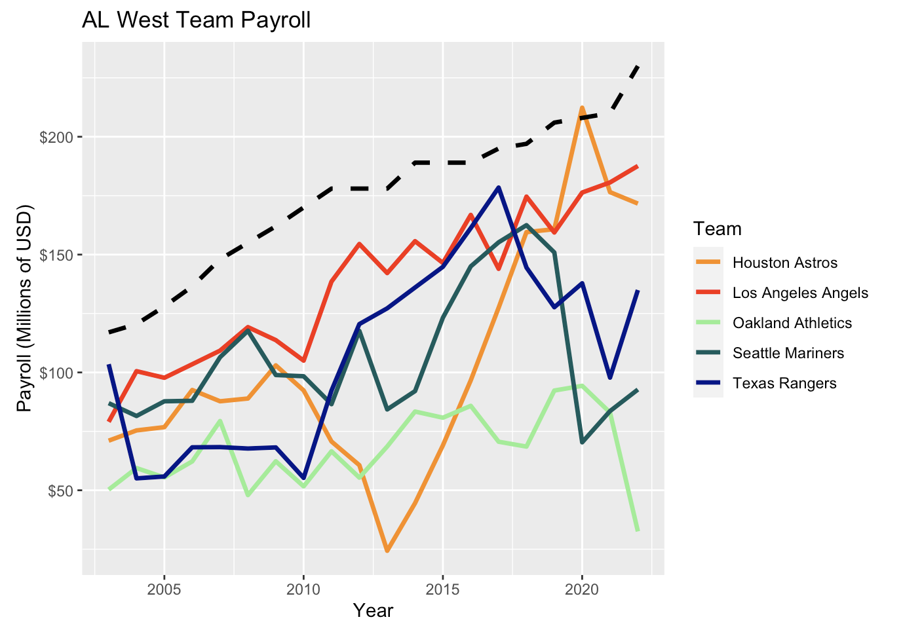
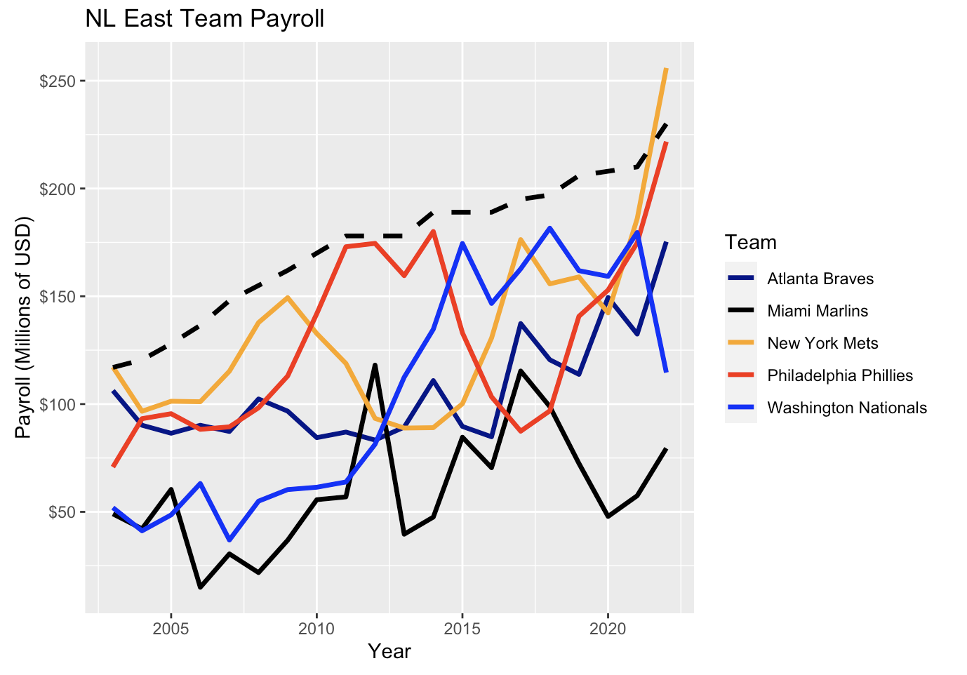
Payroll
Notes:
Payroll graphs
Dashed line is CBT threshold

Slide 7
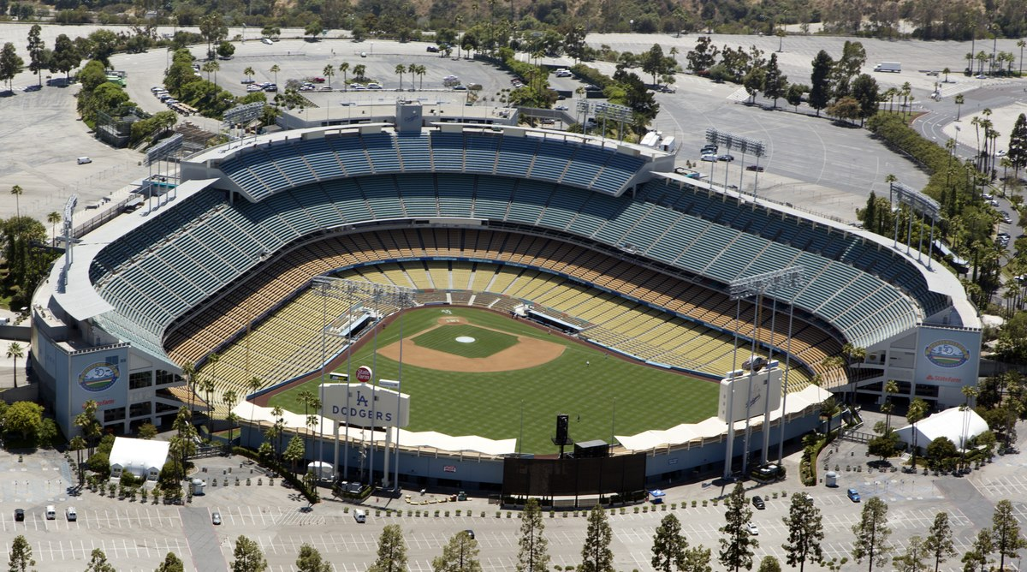
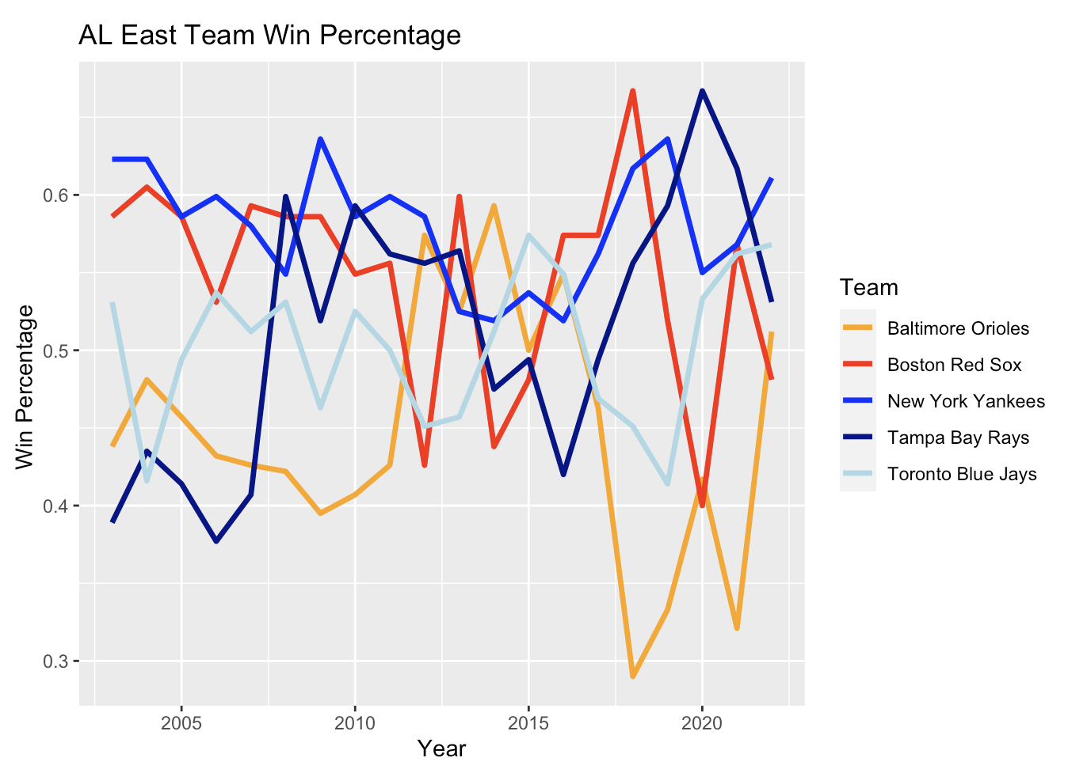
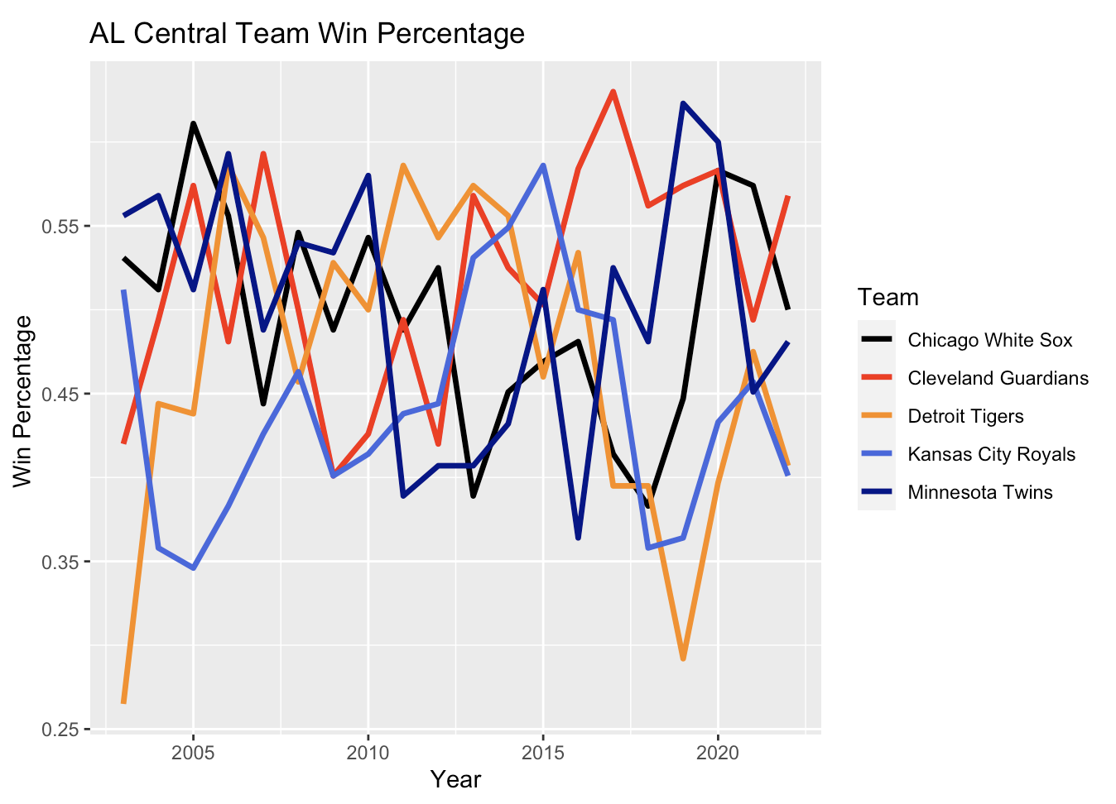
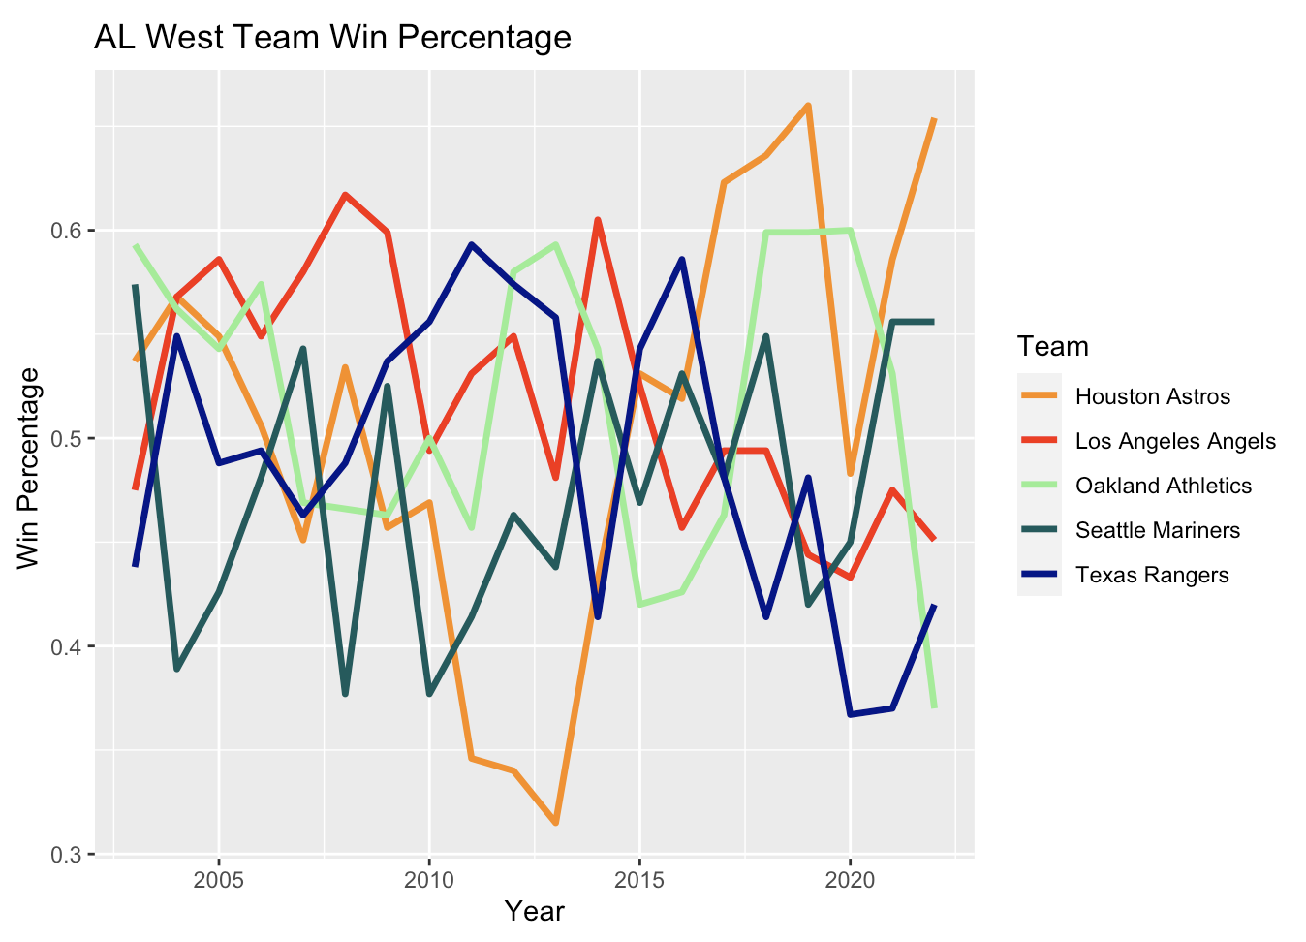
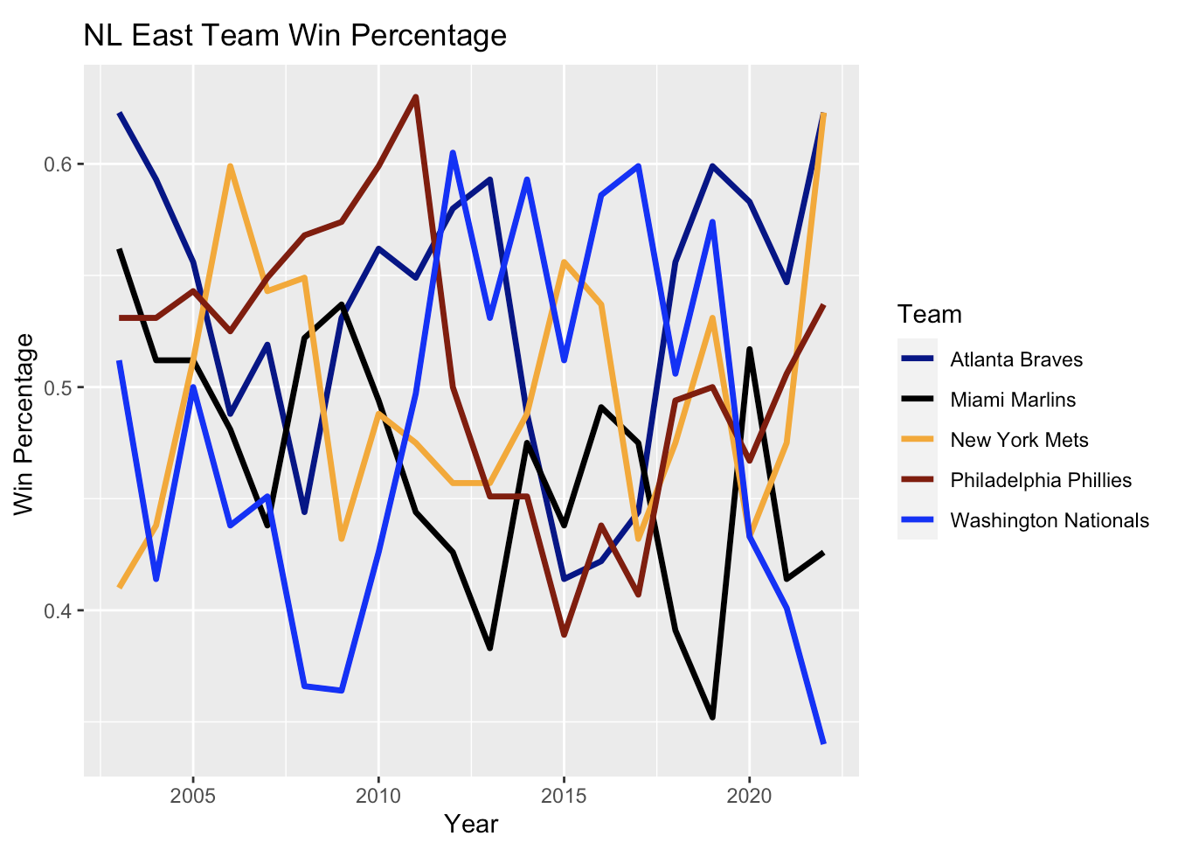
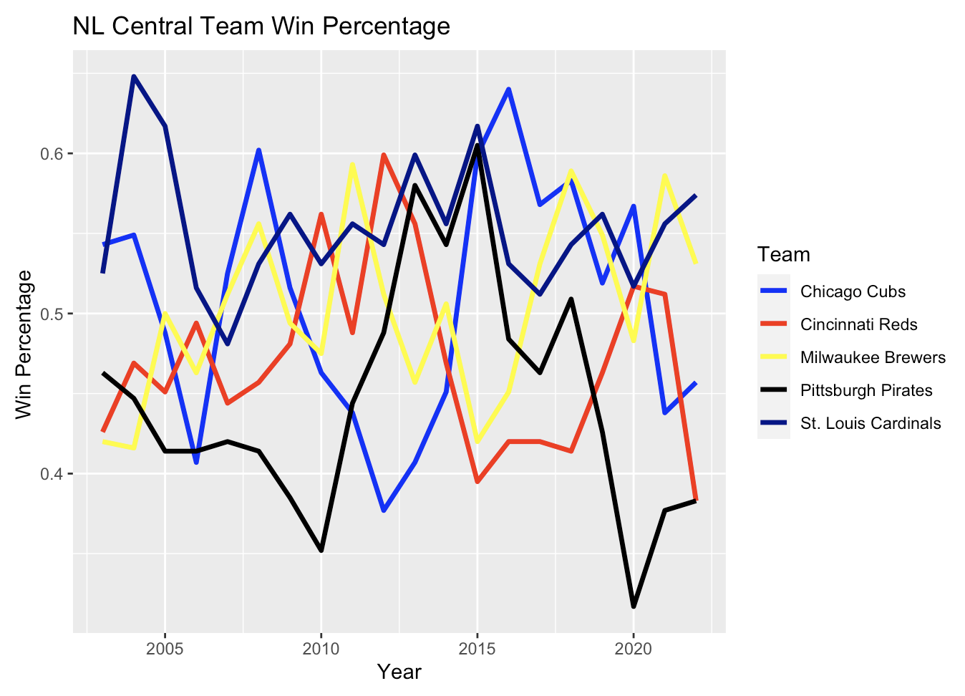
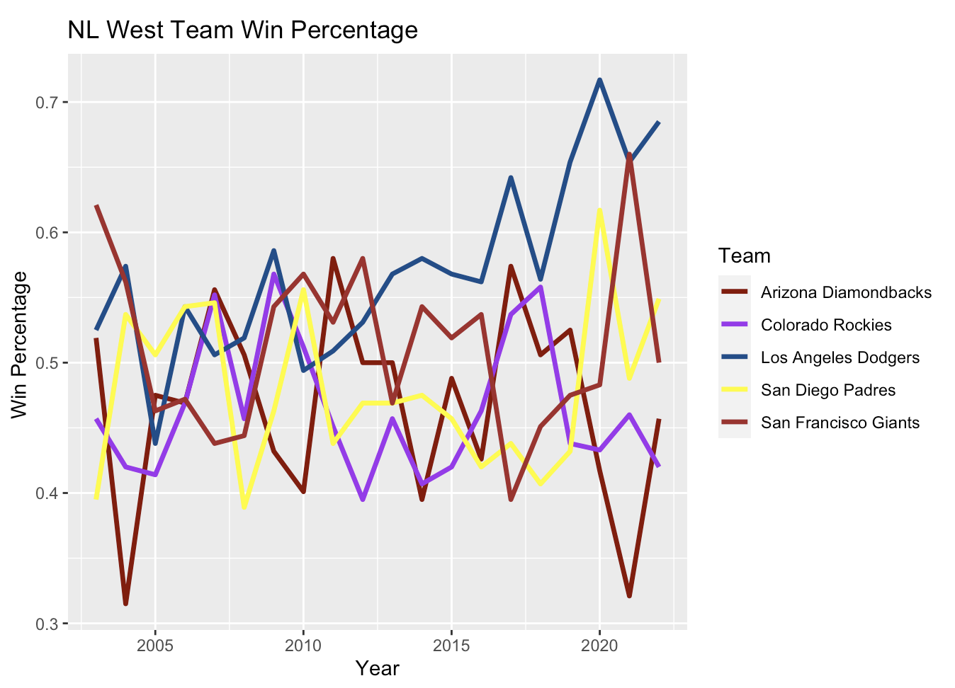
Wins
Notes:
Wins graphs
Much more volatile/stationary

Slide 8
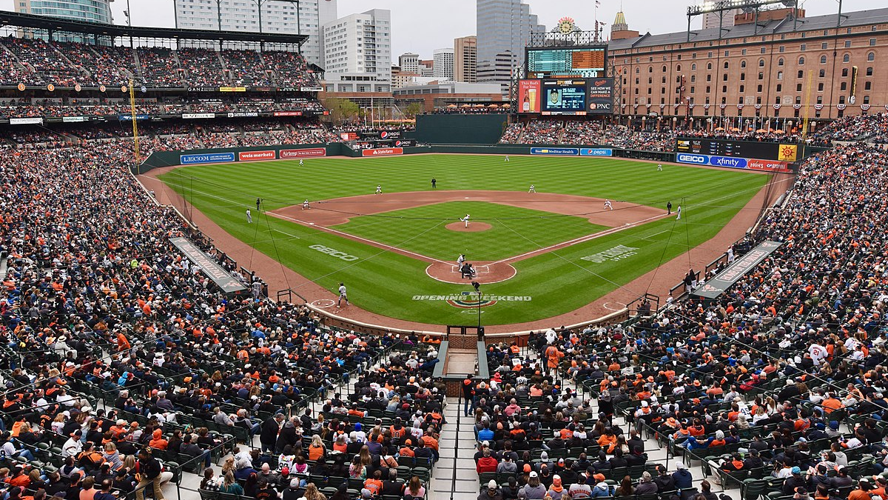
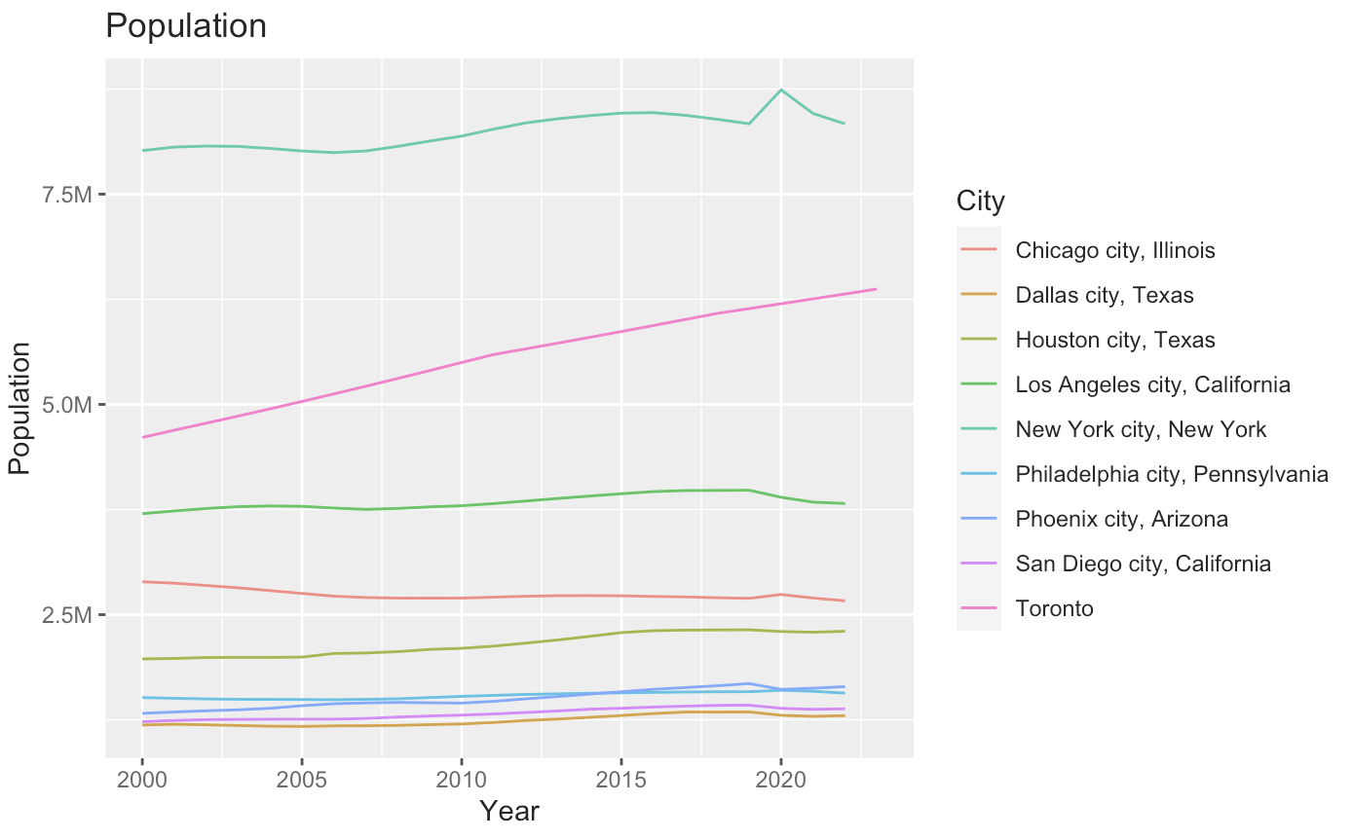
Population
Notes:
Very consistent year over year, little change

Slide 9
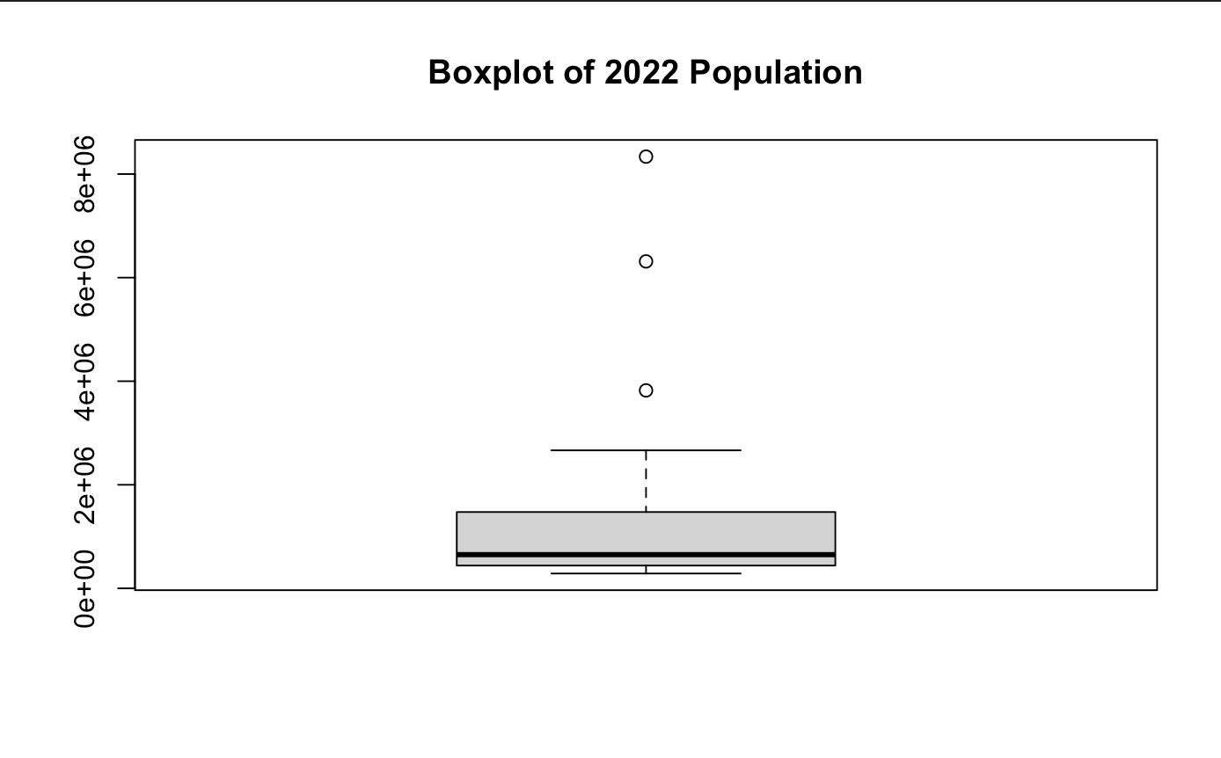
Population
Min. | 1Q | Mean | 3Q | Max.
286578 | 440034 | 1431513 | 1474210 | 8335897
Notes:
Looking at the boxplot, taking every city above the 3Q would be a good metric to determine what cities are “large market” cities by population. This ends up being the 7 largest cities in the league, which ends up including 10 teams

Slide 10
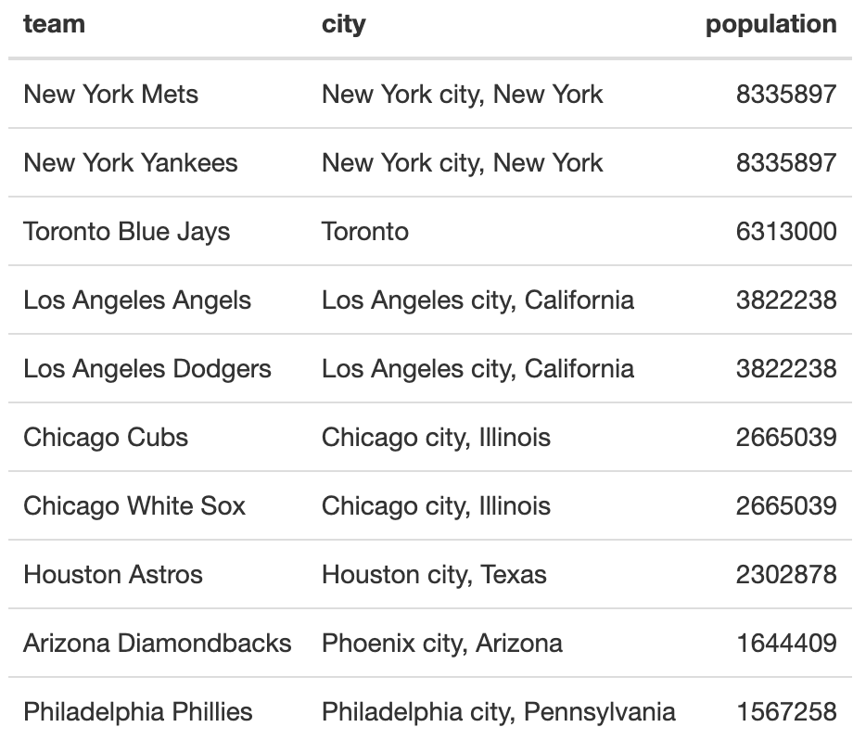
Population

Slide 11
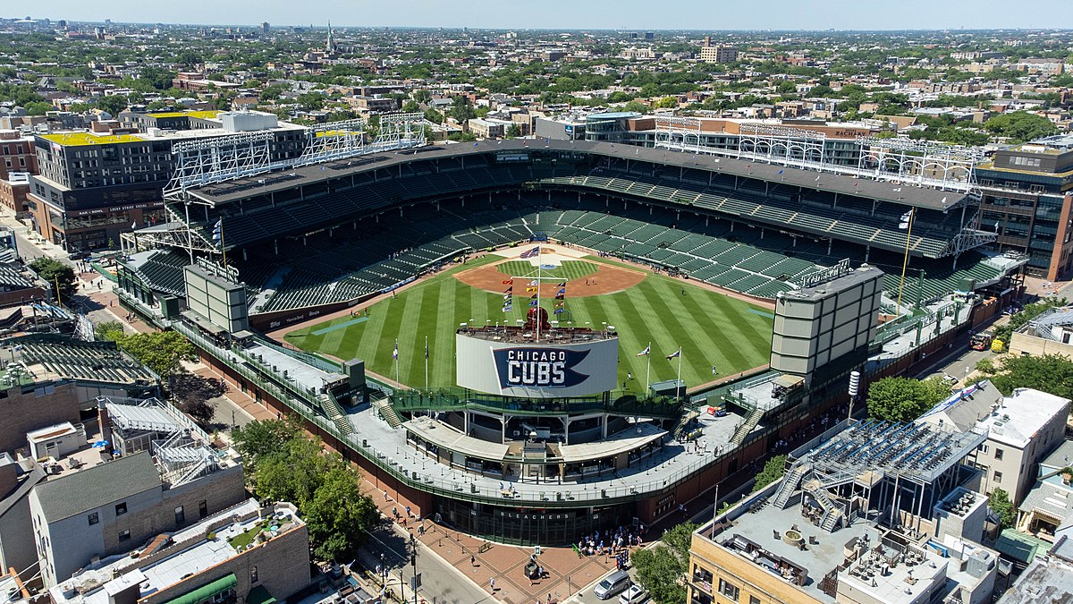
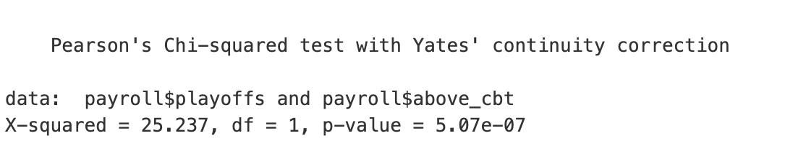
Chi-Square Test
H₀ = Making the playoffs and being above the CBT threshold are independent
H_{a} = Making the playoffs and being above the CBT threshold are not independent
Notes:
The p-value for this test is essentially 0. We can reject the null hypothesis and conclude that playoff appearances and being above the CBT threshold are not independent, there is some relationship between the two. Conventional wisdom would say that this relationship is a postive one in the sense that being above the threshold makes a team more likely to make the playoffs. Now it would be useful to confirm that intuition and if it is true, then quantify just how much of an advantage being above the threshold gives to a team.

Slide 12
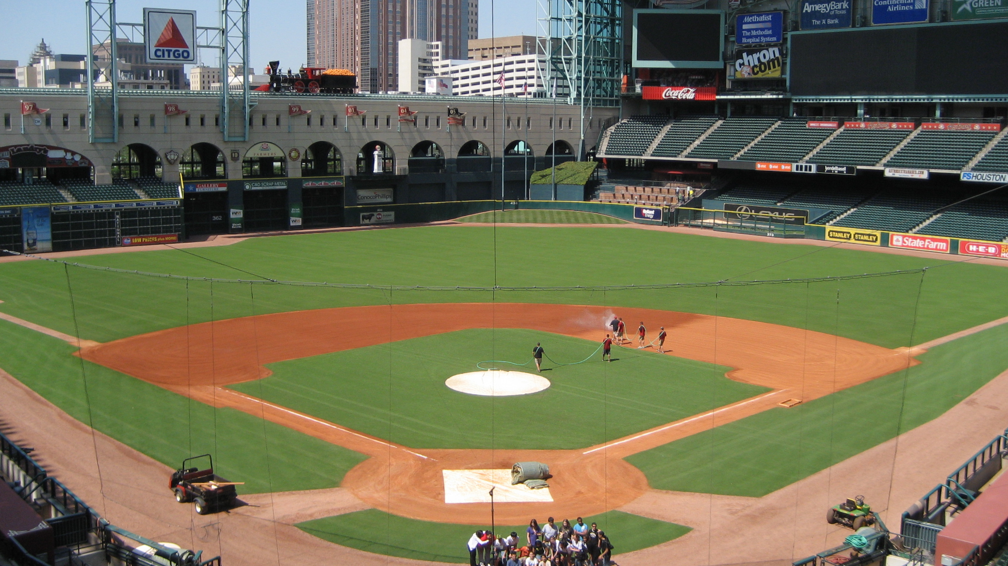
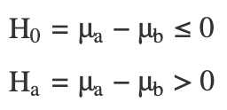
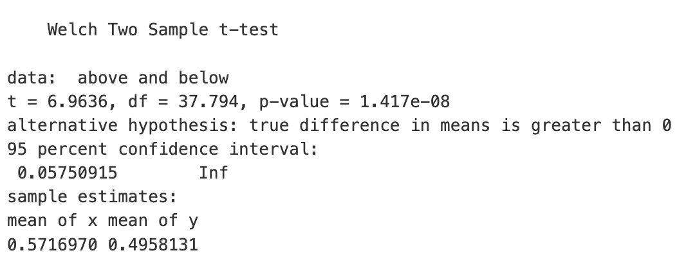
T-Test
Let μ_{b} = mean winning percentage for teams above the CBT threshold.
Let μ_{b} = mean winning percentage for teams below the CBT threshold.
Notes:
Is the average winning percentage for teams below the CBT threshold smaller than the average winning percentage for teams above the CBT threshold?
The p-value from this t-test is essentially 0. We have enough evidence to reject the null hypothesis, teams with a payroll above the CBT threshold have a higher winning percentage than teams below the CBT threshold. We are 95% confident that the true difference of means between the winning percentage of the two populations is greater than 0.0575. This works out to a difference of 9.3 wins over an entire 162 game season, meaning we are 95% confident that teams who exceed the CBT threshold win at least 9 more games than teams that do not.

Slide 13
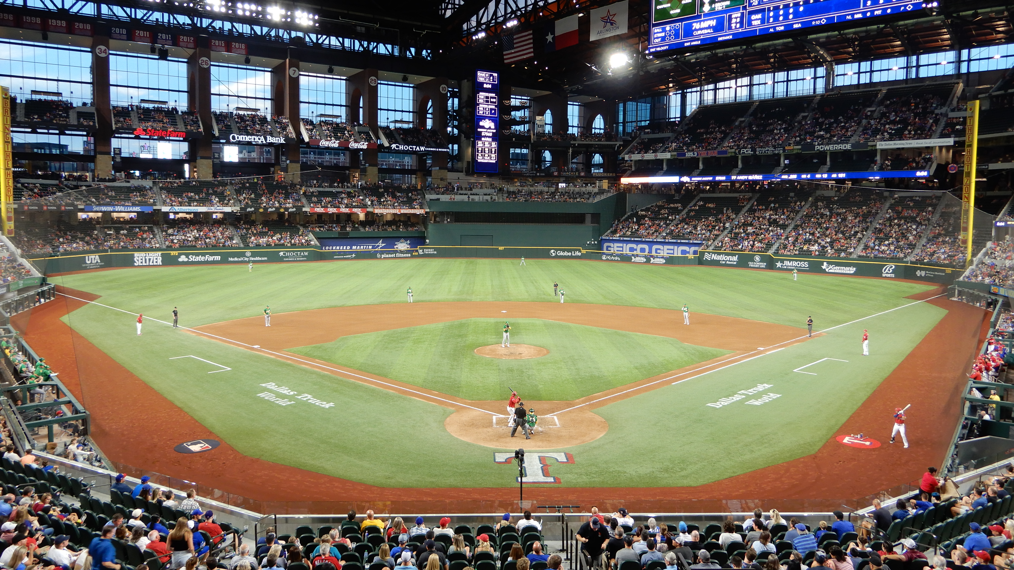
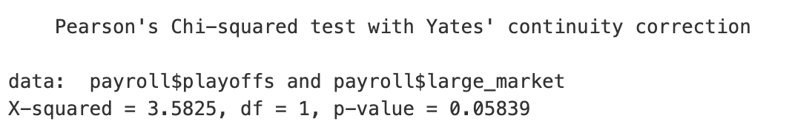
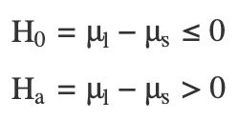
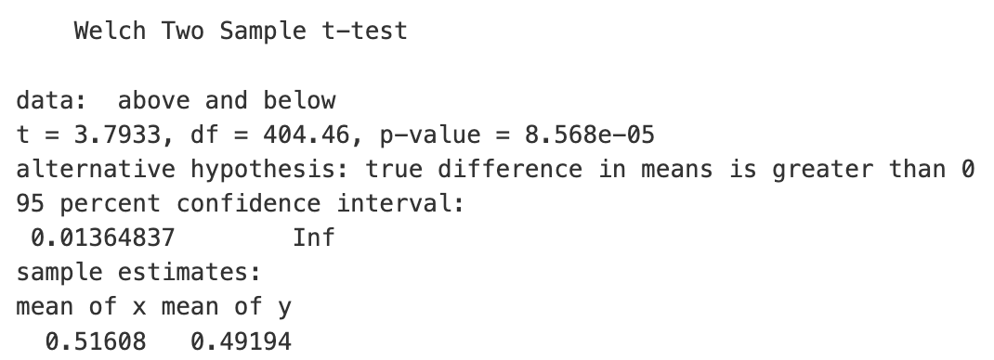
Population Tests
Notes:
Chi-Square
Let’s start by doing the same tests as earlier, but using a team’s market size as a variable instead of their payroll size. First we repeat the chi-square test. The null hypothesis is that making the playoffs and being a large market team independent. The alternative hypothesis is that those two variables are not independent (there is some relationship between the two).
It is close, but a p-value of 0.058 means we cannot reject the null hypothesis at a 95% confidence level. We cannot conclude that there is a relationship between being a large market team and making the playoffs. Since we could reject the null hypothesis at a 90% confidence level, it is still worth continuing to the t-test as we did earlier to figure out how much of a difference being a large market team makes.
T-test
Is the average winning percentage for small market teams smaller than the average winning percentage for large market teams?
The p-value for this test is essentially 0. We have enough evidence to reject the null hypothesis and conclude that large market teams have a better mean winning percentage than small market teams. We are 95% confident that the true difference in mean winning percentage between large and small market teams is greater than 0.0136. This works out to a difference of at least 2 wins over an entire 162 game season meaning we are 95% confident that large market teams win at least 2 more games than small market teams on average.

Slide 14
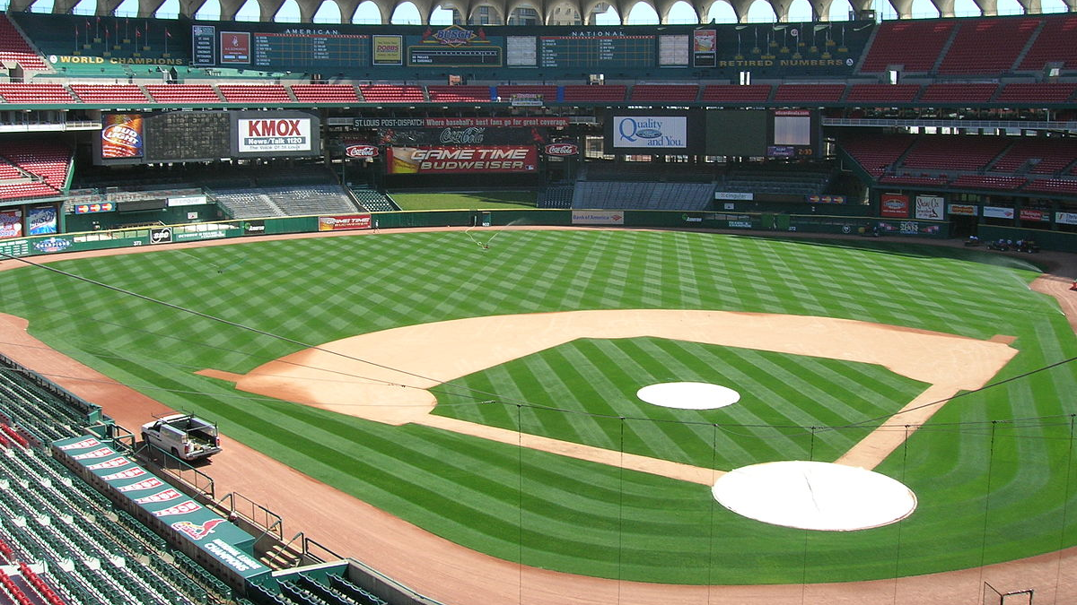
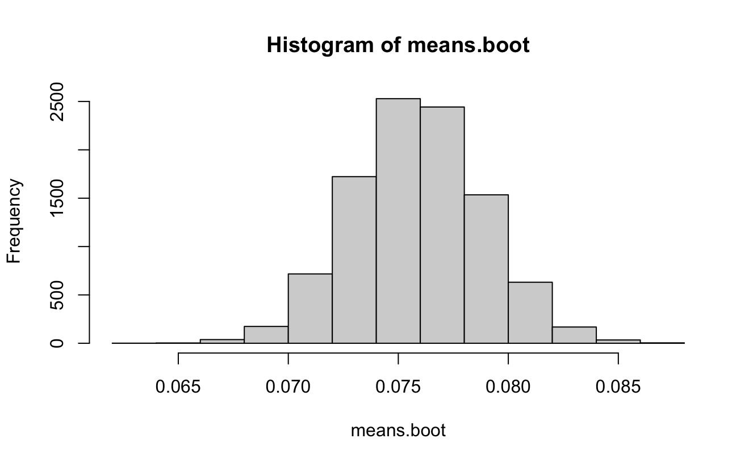
Bootstrap Methods
2.5% | 97.5%
11.37 | 13.25
Notes:
As we only have 600 points of data, bootstrapping may be useful here to get more accurate results. Let’s bootstrap the difference of winning percentage means between teams that exceed the CBT threshold and teams that do not.
Similar results can be seen here as the earlier t-test, as all differences are greater than 0 and most are around 0.07 and 0.08, showing that teams who surpass the CBT threshold have greater winning percentages than teams that do not.
We are 95% confident that the true difference in means between winning percentage for teams above and below the CBT threshold is between 11.3 and 13.3 wins each season. This is larger than the previously determined value of 9 wins, further supporting our hypothesis that teams that surpass the CBT threshold win more games.

Slide 15
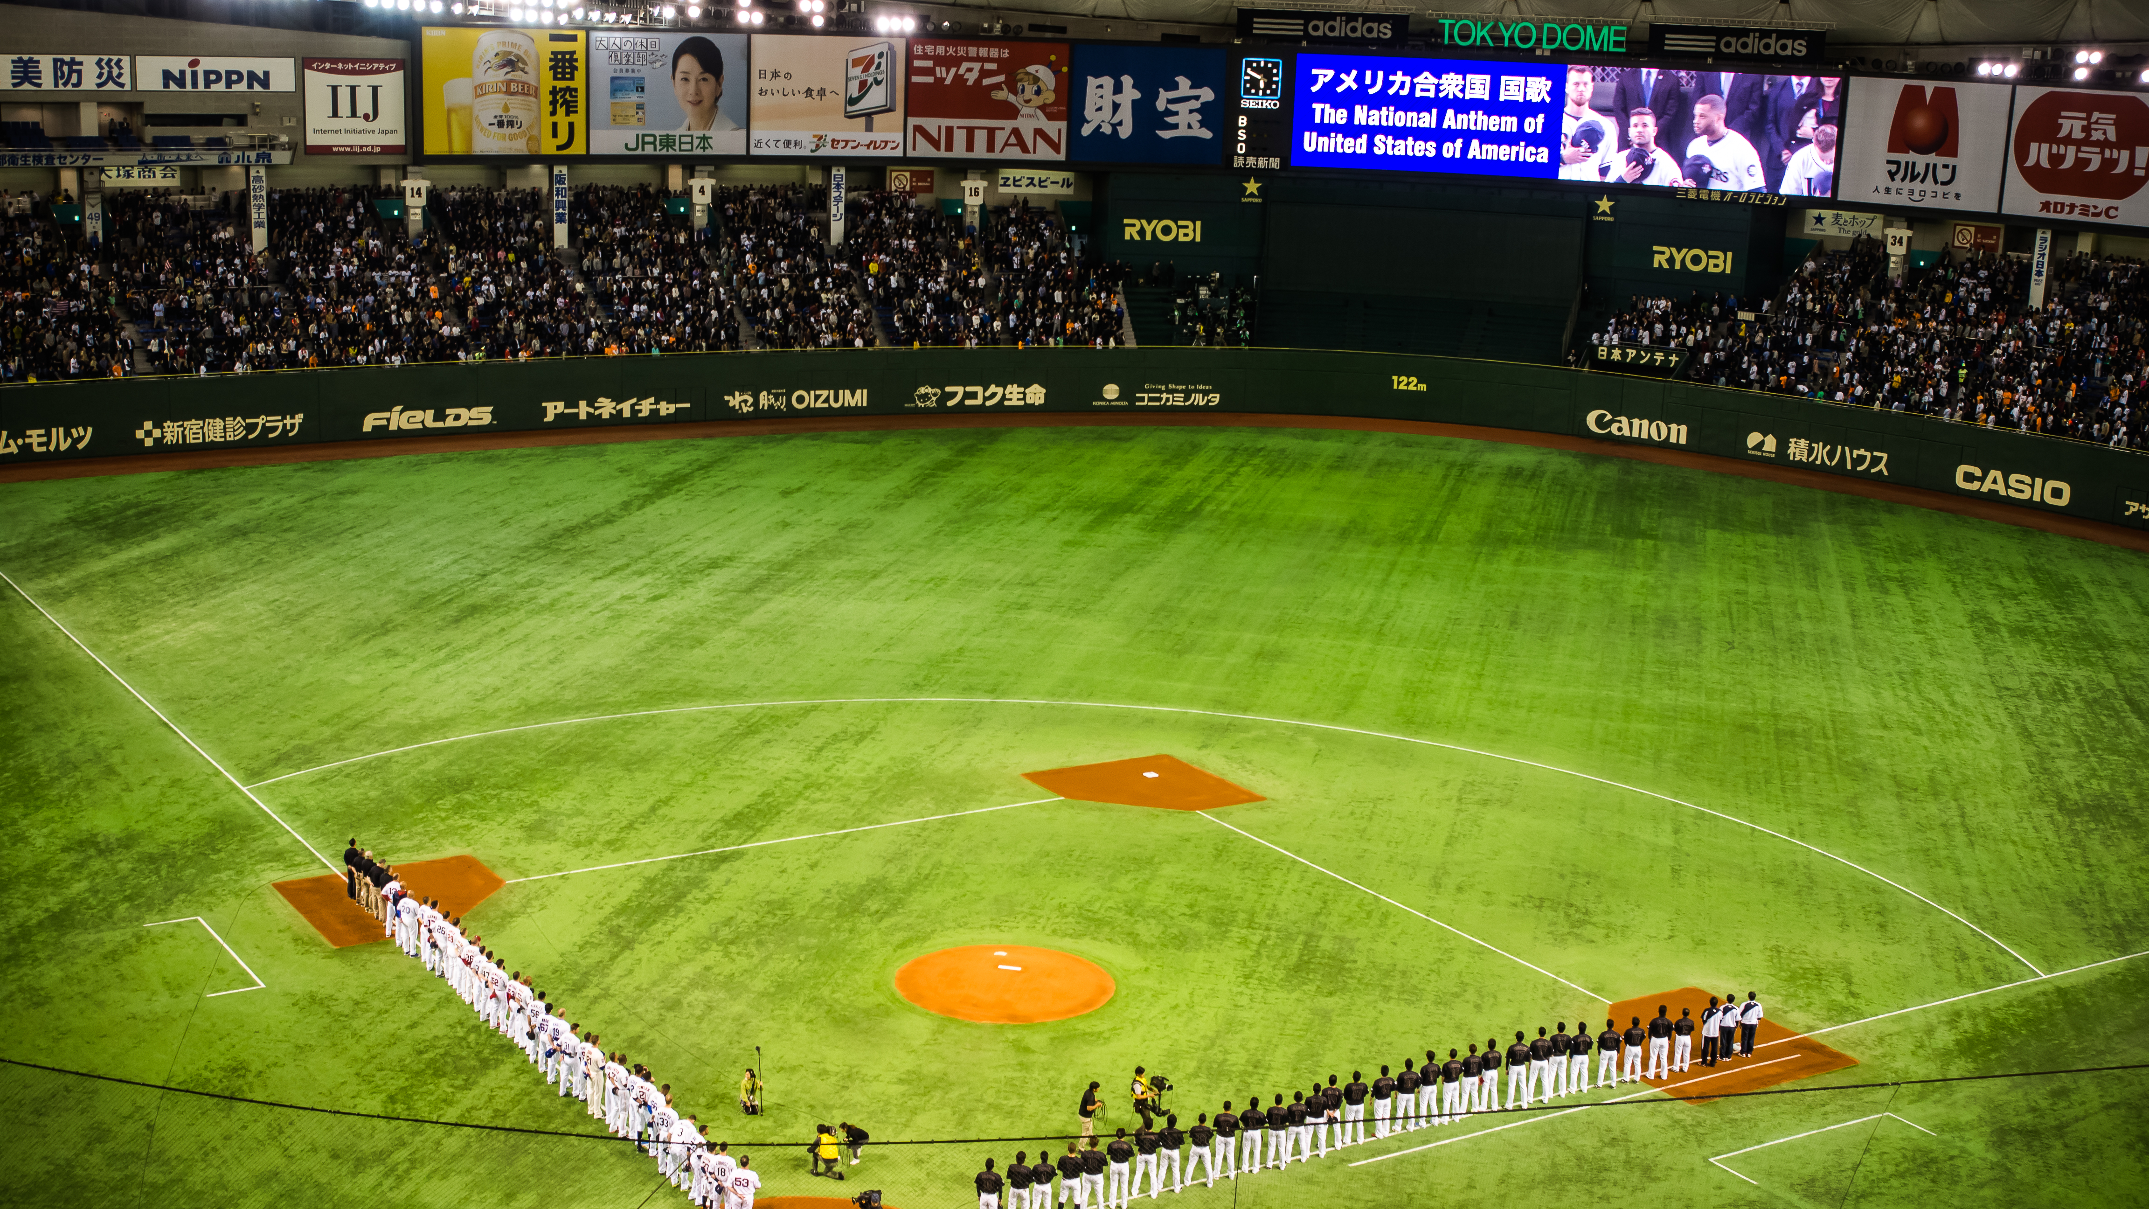
Conclusions
A clear advantage (11 – 13 wins per season) exists for teams that exceed the CBT threshold
Less of a difference exists when comparing teams based on market size, it is the money making a difference not the market size
The penalties are not sufficiently harsh
A gap clearly exists, and a salary cap would help close the gap between rich and poor teams as done in other professional sports leagues

Slide 16
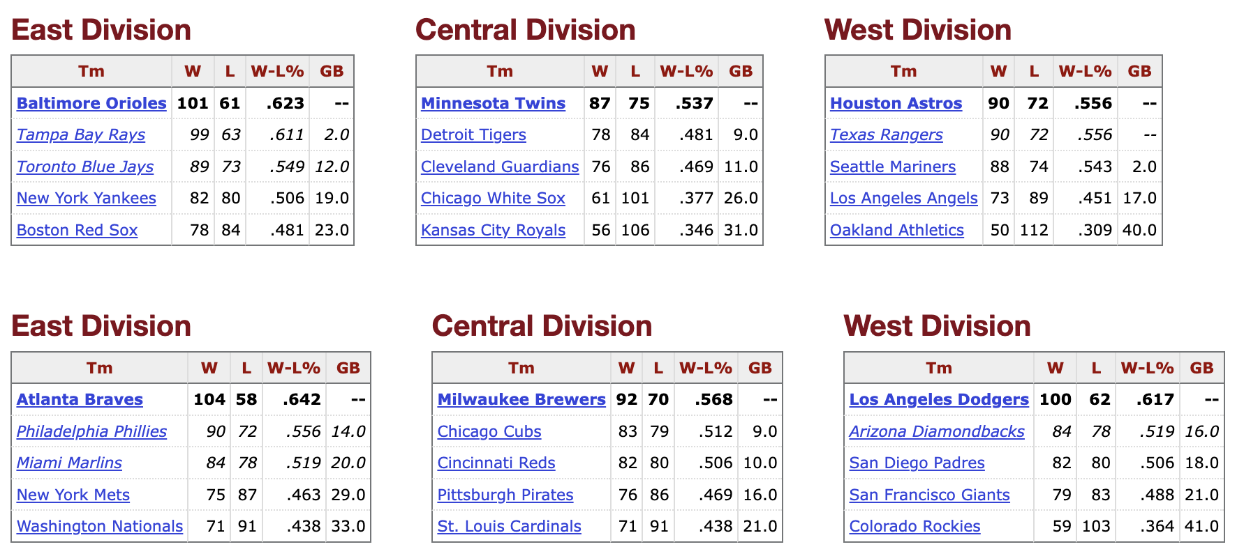

Slide 17
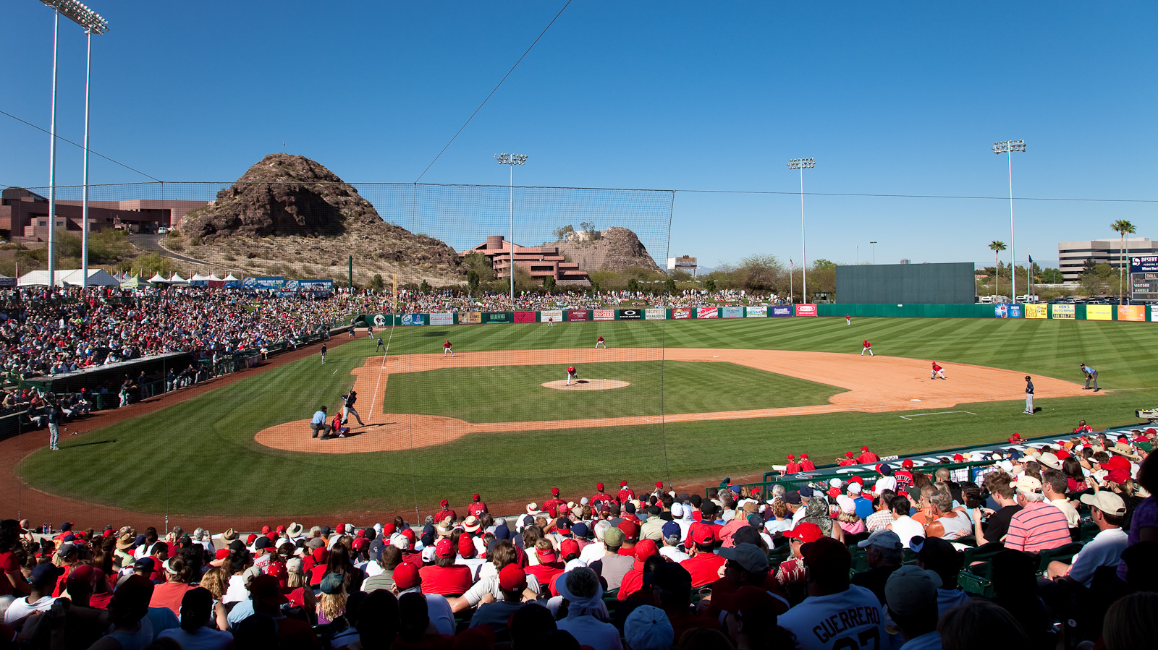
Bibliography
Background images from Wikipedia
“Baseball Reference.” 2023. https://www.baseball-reference.com/teams/.
Bureau, US Census. “City and Town Population Totals: 2020-2022 — Census.gov.” https://www.census.gov/data/tables/time-series/demo/popest/2020s-total-cities-and-towns.html.
“MLB’s Evolving Luxury Tax — Blogs.fangraphs.com.” https://blogs.fangraphs.com/mlbs-evolving-luxury-tax/.
OverTheCap. 2023. “Salary Cap Space.” https://overthecap.com/salary-cap-space.
Retrosheet. 2002. “2002 Payroll.” https://www.thebaseballcube.com/page.asp?PT=payroll_year&ID=2002.
“World Population Prospects 2022.” 2022. https://population.un.org/wpp/.

